Slide 1

Modern Control Theory
Lecture No. 4
Brief Revisit of the Big Picture of Estimation by State Space Concept
Revisit of Examples for Formulating the State Space Equations
Solution of the State Equation
Discretizing the State equation
The State Transition Matrix

Slide 2
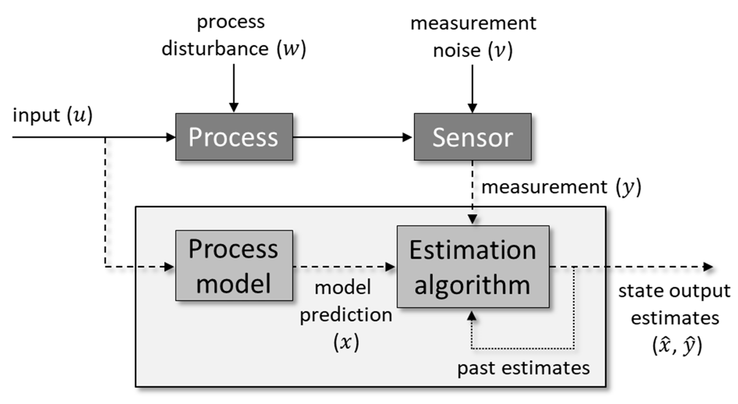
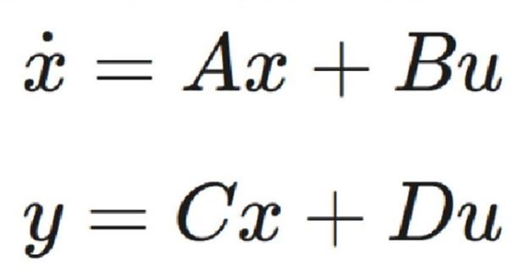
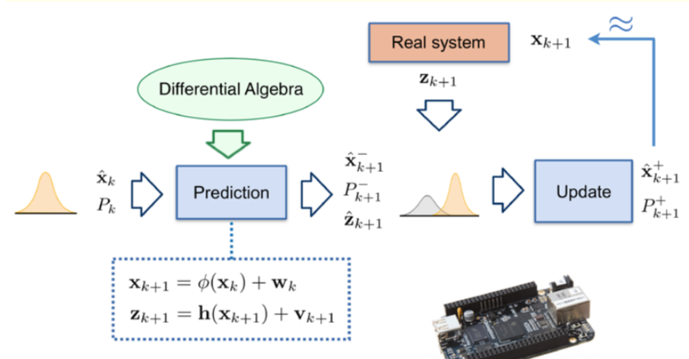
Revisiting ---- The State Space Concept

Slide 3
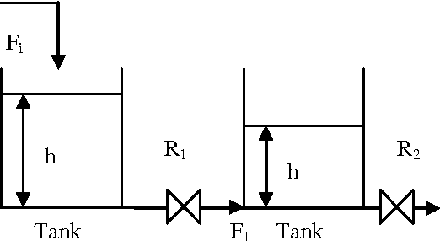
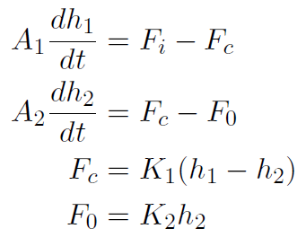
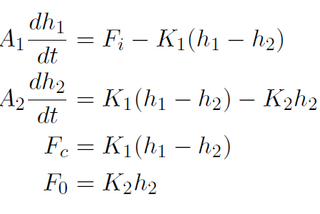
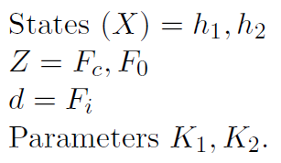
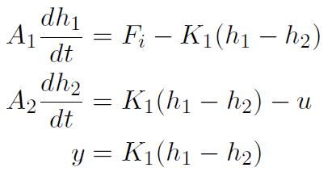


The Coupled Tank Problem

Slide 4
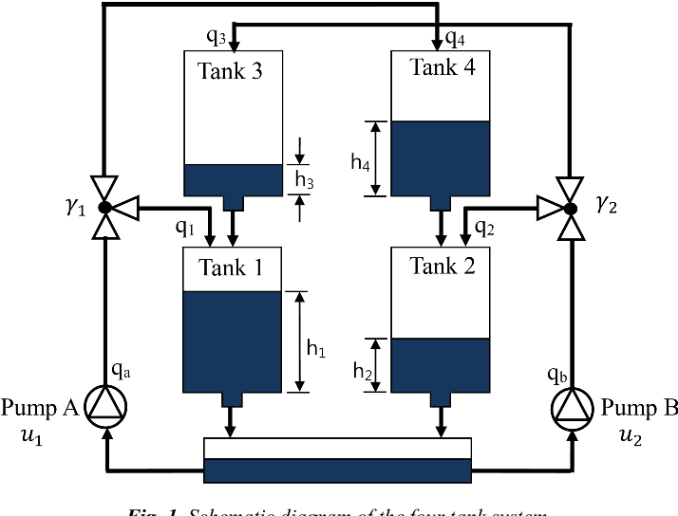
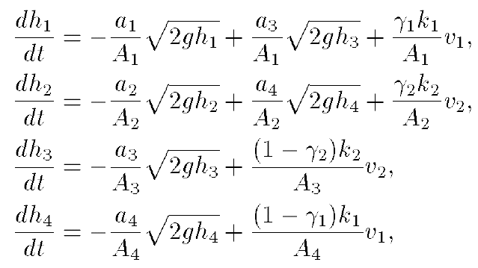
The 4-Tank Problem

Slide 5




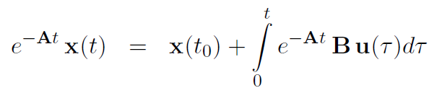
Solution of the State Equation

Slide 6





Solution of the State Equation by Laplace Transforms

Slide 7




Discretizing the State Equation

Slide 8



Properties of the State Transition Matrix

Slide 9





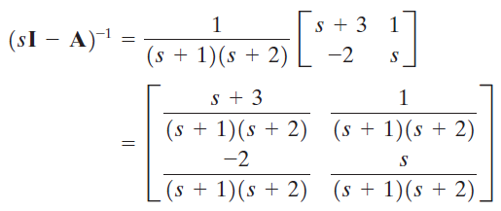

State Transition Matrix

Slide 10
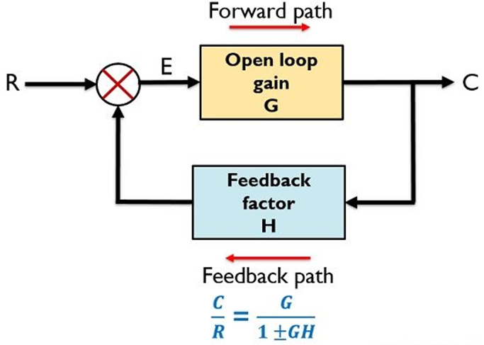
Concept of a Pole/Eigenvalue

